Slide 1
Design-Thinking Workshop
Haverford College

Slide 2
What to call me?
3 Part Design Workshop!
What NOT to call me?
“Prof. Wessling”
or
“Kathryn”
“Dr. Wessling”
“Miss Kathryn”
“Ms. Wessling”

Slide 3
Three Design Thinking challenges for us to solve this evening:
What is it?
What is the mindset?
How to do it?

Slide 4
Three Design Thinking challenges for us to solve this evening:
What is it?
What is the mindset?
How to do it?
Notes:
7:00 - 7:30pm: Workshop Norms (it is okay to make mistakes, a willingness to try anything, and making others the hero)
7:30pm - 8:30pm: Laptop carrying case design challenge exercise
8:30pm - 9:00pm: Debrief & design tool to use during the week

Slide 5
SHOW
Don’t Tell

Slide 6
Notes:
https://www.youtube.com/watch?v=M66ZU2PCIcM&t=207s

Slide 7
SHIFT IN MINDSET

Slide 8
NORM ACTIVITIES

Slide 9
SHIFT IN MINDSET
It’s okay to “fail”
We make others the hero
Willingness to try anything

Slide 10
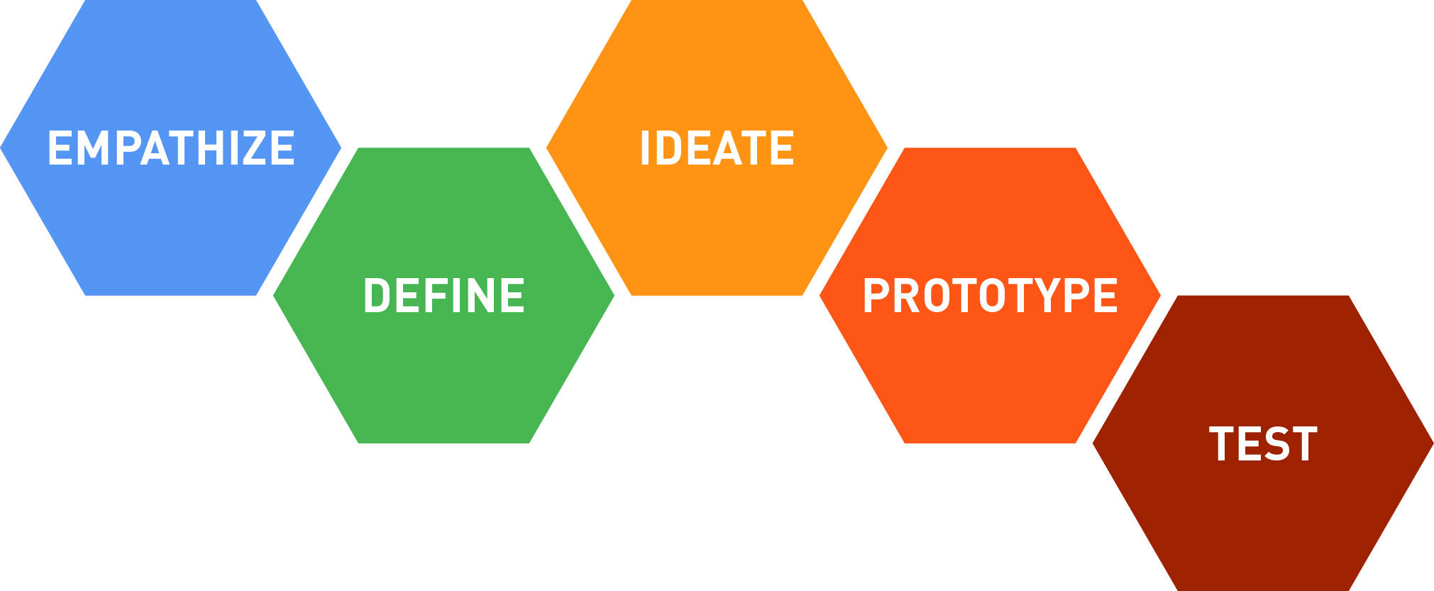
Design Thinking

Slide 11
Summary: What will be learned through this experience?
human-centered design techniques to create innovations to real-world challenges
effective interviewing strategies to deeply understand the humans beings
creative approaches to rapid prototyping to make your ideas come to life

Slide 12
This evening, we will learn how to truly understand and tap into human needs - the only real basis for innovation.
Part 2: THE HUMAN EXPERIENCE
Wednesday, October 11
“In terms of doing work and in terms of learning and evolving as a person, you just grow more when you get more people’s perspectives.”
Notes:
7:00pm- 7:30pm: Discussion of their snacker interviews
7:30pm - 8:30pm: Journey Mapping Exercise
8:30pm - 9:00pm: Debrief & Design Tool to Use before Part 3

Slide 13
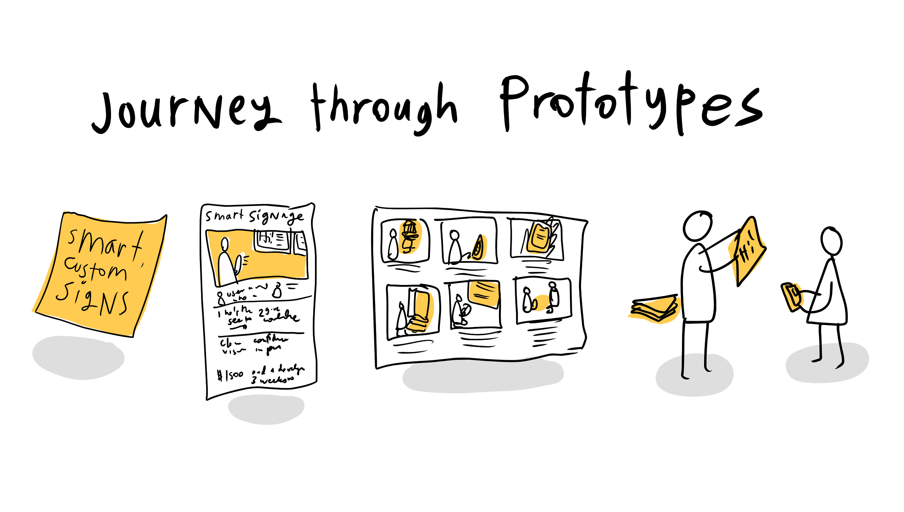
In our last fun & interactive evening, we learn how to roughly prototype our new concepts!
Part 3: The Ins & Outs of
Wednesday, October 25
Rapid Prototyping
Notes:
7:00-7:45pm: User Interview Debriefs
7:45pm - 8:30pm: Prototyping Exercise
8:30pm - 9pm: Review of what we have learned

