Slide 1
Pair-up with someone in class
Groups of 3 will NOT work for this exercise!

Slide 2
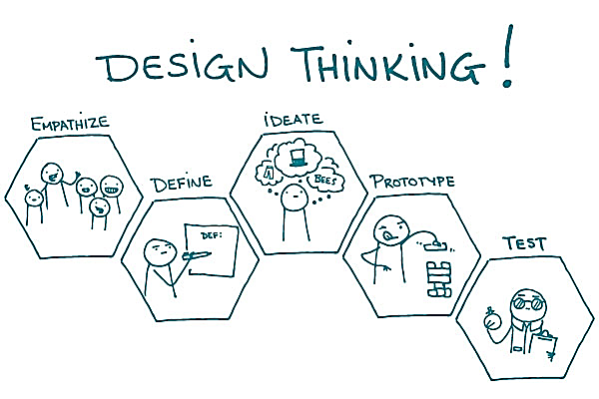

Slide 3
Design Challenge:
“Design a new LAPTOP CARRYING experience.”

Slide 4
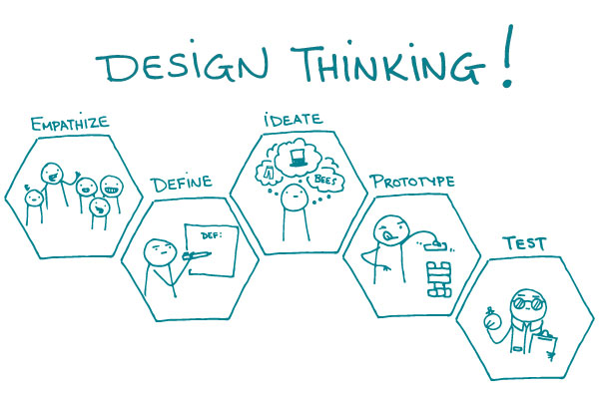

Slide 5
Design a new LAPTOP CARRYING experience…FOR your partner. Start by gaining empathy and understanding.
1. Interview
2. Dig Deeper
4 minutes (each)
3 minutes (each)
Notes from your 1st interview
Notes from your 2nd interview

Slide 6
Design a new laptop carrying experience…FOR your partner. Start by gaining empathy and understanding.
EMPATHY?
Uncover NEEDS that people
Discover the EMOTIONS that guide behaviors
Notes:
https://youtu.be/ZbFTVbLfbZA?t=33s
Go until 1:25

Slide 7
Design a new laptop carrying experience…FOR your partner. Start by gaining empathy and understanding.
1. Interview
4 minutes
(each)
Notes from your 1st interview
Don’t judge.
Just be CURIOUS!
Open ended questions:
Tell me about….
Document everything interesting & surprising!

Slide 8
Design a new laptop carrying experience…FOR your partner. Start by gaining empathy and understanding.
1. Interview
4 minutes
(each)
Notes from your 1st interview
Time begins on next slide:
Determine who will first ask the questions.
(we will switch after 4 mins)

Slide 9
Design a new laptop carrying experience…FOR your partner. Start by gaining empathy and understanding.
1. Interview
4 minutes
(each)
Notes from your 1st interview
Person A
03
59
58
57
56
55
54
53
52
51
50
49
48
47
46
45
44
43
42
41
40
39
38
37
36
35
34
33
32
31
30
29
28
27
26
25
24
23
22
21
20
19
18
17
16
15
14
13
12
11
10
09
08
07
06
05
04
03
02
01
00

Slide 10
Design a new laptop carrying experience…FOR your partner. Start by gaining empathy and understanding.
1. Interview
4 minutes
(each)
Notes from your 1st interview
Person A
02
59
58
57
56
55
54
53
52
51
50
49
48
47
46
45
44
43
42
41
40
39
38
37
36
35
34
33
32
31
30
29
28
27
26
25
24
23
22
21
20
19
18
17
16
15
14
13
12
11
10
09
08
07
06
05
04
03
02
01
00

Slide 11
Design a new laptop carrying experience…FOR your partner. Start by gaining empathy and understanding.
1. Interview
4 minutes
(each)
Notes from your 1st interview
Person A
01
59
58
57
56
55
54
53
52
51
50
49
48
47
46
45
44
43
42
41
40
39
38
37
36
35
34
33
32
31
30
29
28
27
26
25
24
23
22
21
20
19
18
17
16
15
14
13
12
11
10
09
08
07
06
05
04
03
02
01
00

Slide 12
Design a new laptop carrying experience…FOR your partner. Start by gaining empathy and understanding.
1. Interview
4 minutes
(each)
Notes from your 1st interview
Person A
00
59
58
57
56
55
54
53
52
51
50
49
48
47
46
45
44
43
42
41
40
39
38
37
36
35
34
33
32
31
30
29
28
27
26
25
24
23
22
21
20
19
18
17
16
15
14
13
12
11
10
09
08
07
06
05
04
03
02
01
00

Slide 13
Design a new laptop carrying experience…FOR your partner. Start by gaining empathy and understanding.
1. Interview
4 minutes
(each)
Notes from your 1st interview
Person A
00
00
Person B
03
59
58
57
56
55
54
53
52
51
50
49
48
47
46
45
44
43
42
41
40
39
38
37
36
35
34
33
32
31
30
29
28
27
26
25
24
23
22
21
20
19
18
17
16
15
14
13
12
11
10
09
08
07
06
05
04
03
02
01
00

Slide 14
Design a new laptop carrying experience…FOR your partner. Start by gaining empathy and understanding.
1. Interview
4 minutes
(each)
Notes from your 1st interview
Person A
00
00
Person B
02
59
58
57
56
55
54
53
52
51
50
49
48
47
46
45
44
43
42
41
40
39
38
37
36
35
34
33
32
31
30
29
28
27
26
25
24
23
22
21
20
19
18
17
16
15
14
13
12
11
10
09
08
07
06
05
04
03
02
01
00

Slide 15
Design a new laptop carrying experience…FOR your partner. Start by gaining empathy and understanding.
1. Interview
4 minutes
(each)
Notes from your 1st interview
Person A
00
00
Person B
01
59
58
57
56
55
54
53
52
51
50
49
48
47
46
45
44
43
42
41
40
39
38
37
36
35
34
33
32
31
30
29
28
27
26
25
24
23
22
21
20
19
18
17
16
15
14
13
12
11
10
09
08
07
06
05
04
03
02
01
00

Slide 16
Design a new laptop carrying experience…FOR your partner. Start by gaining empathy and understanding.
1. Interview
4 minutes
(each)
Notes from your 1st interview
Person A
00
00
Person B
00
59
58
57
56
55
54
53
52
51
50
49
48
47
46
45
44
43
42
41
40
39
38
37
36
35
34
33
32
31
30
29
28
27
26
25
24
23
22
21
20
19
18
17
16
15
14
13
12
11
10
09
08
07
06
05
04
03
02
01
00

Slide 17
Design a new laptop carrying experience…FOR your partner. Start by gaining empathy and understanding.
1. Interview
2. Dig Deeper
4 minutes
3 minutes
Notes from your 1st interview
Notes from your 2nd interview
✔
Follow up on things that intrigued you…
Dig for stories, feelings, & emotions…
YOU WILL BE DESIGNING A PRODUCT BASED ON THIS INSIGHT!

Slide 18
Design a new laptop carrying experience…FOR your partner. Start by gaining empathy and understanding.
1. Interview
2. Dig Deeper
4 minutes
3 minutes
(each)
(each)
Notes from your 1st interview
Notes from your 2nd interview
Person A
✔
02
59
58
57
56
55
54
53
52
51
50
49
48
47
46
45
44
43
42
41
40
39
38
37
36
35
34
33
32
31
30
29
28
27
26
25
24
23
22
21
20
19
18
17
16
15
14
13
12
11
10
09
08
07
06
05
04
03
02
01
00

Slide 19
Design a new laptop carrying experience…FOR your partner. Start by gaining empathy and understanding.
1. Interview
2. Dig Deeper
4 minutes
3 minutes
(each)
(each)
Notes from your 1st interview
Notes from your 2nd interview
Person A
✔
01
59
58
57
56
55
54
53
52
51
50
49
48
47
46
45
44
43
42
41
40
39
38
37
36
35
34
33
32
31
30
29
28
27
26
25
24
23
22
21
20
19
18
17
16
15
14
13
12
11
10
09
08
07
06
05
04
03
02
01
00

Slide 20
Design a new laptop carrying experience…FOR your partner. Start by gaining empathy and understanding.
1. Interview
2. Dig Deeper
4 minutes
3 minutes
(each)
(each)
Notes from your 1st interview
Notes from your 2nd interview
Person A
✔
00
59
58
57
56
55
54
53
52
51
50
49
48
47
46
45
44
43
42
41
40
39
38
37
36
35
34
33
32
31
30
29
28
27
26
25
24
23
22
21
20
19
18
17
16
15
14
13
12
11
10
09
08
07
06
05
04
03
02
01
00

Slide 21
Design a new laptop carrying experience…FOR your partner. Start by gaining empathy and understanding.
1. Interview
2. Dig Deeper
4 minutes
3 minutes
(each)
(each)
Notes from your 1st interview
Notes from your 2nd interview
Person A
✔
00
00
Person B
02
59
58
57
56
55
54
53
52
51
50
49
48
47
46
45
44
43
42
41
40
39
38
37
36
35
34
33
32
31
30
29
28
27
26
25
24
23
22
21
20
19
18
17
16
15
14
13
12
11
10
09
08
07
06
05
04
03
02
01
00

Slide 22
Design a new laptop carrying experience…FOR your partner. Start by gaining empathy and understanding.
1. Interview
2. Dig Deeper
4 minutes
3 minutes
(each)
(each)
Notes from your 1st interview
Notes from your 2nd interview
Person A
✔
00
00
Person B
01
59
58
57
56
55
54
53
52
51
50
49
48
47
46
45
44
43
42
41
40
39
38
37
36
35
34
33
32
31
30
29
28
27
26
25
24
23
22
21
20
19
18
17
16
15
14
13
12
11
10
09
08
07
06
05
04
03
02
01
00

Slide 23
Design a new laptop carrying experience…FOR your partner. Start by gaining empathy and understanding.
1. Interview
2. Dig Deeper
4 minutes
3 minutes
(each)
(each)
Notes from your 1st interview
Notes from your 2nd interview
Person A
✔
00
00
Person B
00
59
58
57
56
55
54
53
52
51
50
49
48
47
46
45
44
43
42
41
40
39
38
37
36
35
34
33
32
31
30
29
28
27
26
25
24
23
22
21
20
19
18
17
16
15
14
13
12
11
10
09
08
07
06
05
04
03
02
01
00

Slide 24
Notes:
https://youtu.be/ZbFTVbLfbZA?t=33s
Go until 1:25

Slide 25
Reframe the problem.
INDIVIDUALLY, take 3 min to collect your thoughts and reflect on what you have learned
3. Capture Findings
3 min
(silently)
Goals and wishes: what is your partner trying to achieve? (use verbs)
Synthesize your learning into two groups:
(1) Partner’s goals & wishes
(2) Insights, feelings, & emotions
(1)
Insights: New learnings about your partner’s feelings and motivations. What’s something you see about your partner’s experience that maybe s/he doesn’t see? (make inferences from what you heard)
Insights: New learnings about your partner’s feelings and motivations. What’s something you see about your partner’s experience that maybe s/he doesn’t see? (make inferences from what you heard)
(2)
Notes:
https://www.youtube.com/watch?v=mPf1W5LfsEk
Individually, take 3 min to collect your thoughts and reflect on what you have learned about your partner.
Synthesize your learning into two groups:
Partner’s goals & wishes.
Insights you discovered.

Slide 26
Reframe the problem.
3. Capture Findings
3 min
(silently)
Goals and wishes: what is your partner trying to achieve? (use verbs)
02
59
58
57
56
55
54
53
52
51
50
49
48
47
46
45
44
43
42
41
40
39
38
37
36
35
34
33
32
31
30
29
28
27
26
25
24
23
22
21
20
19
18
17
16
15
14
13
12
11
10
09
08
07
06
05
04
03
02
01
00
Insights: New learnings about your partner’s feelings and motivations. What’s something you see about your partner’s experience that maybe s/he doesn’t see? (make inferences from what you heard)
Notes:
https://www.youtube.com/watch?v=mPf1W5LfsEk

Slide 27
Reframe the problem.
3. Capture Findings
3 min
(silently)
Goals and wishes: what is your partner trying to achieve? (use verbs)
01
59
58
57
56
55
54
53
52
51
50
49
48
47
46
45
44
43
42
41
40
39
38
37
36
35
34
33
32
31
30
29
28
27
26
25
24
23
22
21
20
19
18
17
16
15
14
13
12
11
10
09
08
07
06
05
04
03
02
01
00
Insights: New learnings about your partner’s feelings and motivations. What’s something you see about your partner’s experience that maybe s/he doesn’t see? (make inferences from what you heard)

Slide 28
Reframe the problem.
3. Capture Findings
3 min
(silently)
Goals and wishes: what is your partner trying to achieve? (use verbs)
00
59
58
57
56
55
54
53
52
51
50
49
48
47
46
45
44
43
42
41
40
39
38
37
36
35
34
33
32
31
30
29
28
27
26
25
24
23
22
21
20
19
18
17
16
15
14
13
12
11
10
09
08
07
06
05
04
03
02
01
00
Insights: New learnings about your partner’s feelings and motivations. What’s something you see about your partner’s experience that maybe s/he doesn’t see? (make inferences from what you heard)

Slide 29
Reframe the problem.
3. Capture Findings
4. Take a stand with a POV
3 min
3 min
(silently)
(silently)
Goals and wishes: what is your partner trying to achieve? (use verbs)
✔
Partner’s name/description
Needs a way to
User’s need
Insights: New learnings about your partner’s feelings and motivations. What’s something you see about your partner’s experience that maybe s/he doesn’t see? (make inferences from what you heard)
because (or “but…” or “surprisingly…”)
[Circle one]
Insight

Slide 30
Reframe the problem.
3. Capture Findings
4. Take a stand with a POV
3 min
2 min
(silently)
(silently)
Goals and wishes: what is your partner trying to achieve? (use verbs)
Select the most compelling goal & interesting insight to articulate a problem statement.
Take a stand by stating the meaningful challenge you are going to take on.
This statement will fuel your design.
✔
Insights: New learnings about your partner’s feelings and motivations. What’s something you see about your partner’s experience that maybe s/he doesn’t see? (make inferences from what you heard)

Slide 31
Reframe the problem.
3. Capture Findings
4. Take a stand with a POV
3 min
2 min
(silently)
(silently)
Goals and wishes: what is your partner trying to achieve? (use verbs)
A teenage girl with a bleak outlook
✔
Personal description of interviewee
feel more socially accepted
when eating healthy food
Needs a way to
Interviewee’s need
Insights: New learnings about your partner’s feelings and motivations. What’s something you see about your partner’s experience that maybe s/he doesn’t see? (make inferences from what you heard)
because (or “but…” or “surprisingly…”)
[Circle one]
in her neighborhood a social risk is more
dangerous than a health risk.
Insight

Slide 32
Reframe the problem.
3. Capture Findings
4. Take a stand with a POV
3 min
2 min
(silently)
(silently)
Goals and wishes: what is your partner trying to achieve? (use verbs)
✔
Partner’s name/description
Needs a way to
User’s need
Insights: New learnings about your partner’s feelings and motivations. What’s something you see about your partner’s experience that maybe s/he doesn’t see? (make inferences from what you heard)
because (or “but…” or “surprisingly…”)
[Circle one]
Insight

Slide 33
Reframe the problem.
3. Capture Findings
4. Take a stand with a POV
3 min
2 min
(silently)
(silently)
Goals and wishes: what is your partner trying to achieve? (use verbs)
✔
Partner’s name/description
Needs a way to
User’s need
Insights: New learnings about your partner’s feelings and motivations. What’s something you see about your partner’s experience that maybe s/he doesn’t see? (make inferences from what you heard)
because (or “but…” or “surprisingly…”)
[Circle one]
01
59
58
57
56
55
54
53
52
51
50
49
48
47
46
45
44
43
42
41
40
39
38
37
36
35
34
33
32
31
30
29
28
27
26
25
24
23
22
21
20
19
18
17
16
15
14
13
12
11
10
09
08
07
06
05
04
03
02
01
00
Insight

Slide 34
Reframe the problem.
3. Capture Findings
4. Take a stand with a POV
3 min
2 min
(silently)
(silently)
Goals and wishes: what is your partner trying to achieve? (use verbs)
✔
Partner’s name/description
Needs a way to
User’s need
Insights: New learnings about your partner’s feelings and motivations. What’s something you see about your partner’s experience that maybe s/he doesn’t see? (make inferences from what you heard)
because (or “but…” or “surprisingly…”)
[Circle one]
00
59
58
57
56
55
54
53
52
51
50
49
48
47
46
45
44
43
42
41
40
39
38
37
36
35
34
33
32
31
30
29
28
27
26
25
24
23
22
21
20
19
18
17
16
15
14
13
12
11
10
09
08
07
06
05
04
03
02
01
00
Insight

Slide 35
Goal:
to explore new and diverse ideas to solve your partner’s need
DO NOT WORRY ABOUT FEASIBILITY
Notes:
https://youtu.be/ZbFTVbLfbZA?t=33s
Go until 1:25

Slide 36
Ideate: generate alternatives to test.
5. Sketch at least 5 radical ways to meet your user’s needs.
5 min
(silently)
Write your problem statement above
Notes:
Creating solutions to the new challenge you identified.
Volume. Idea generation and not evaluation.
Be visual. Sketches. Use words only when necessary.

Slide 37
Ideate: generate alternatives to test.
5. Sketch at least 5 radical ways to meet your user’s needs.
5 min
(silently)
Write your problem statement above
04
59
58
57
56
55
54
53
52
51
50
49
48
47
46
45
44
43
42
41
40
39
38
37
36
35
34
33
32
31
30
29
28
27
26
25
24
23
22
21
20
19
18
17
16
15
14
13
12
11
10
09
08
07
06
05
04
03
02
01
00

Slide 38
Ideate: generate alternatives to test.
5. Sketch at least 5 radical ways to meet your user’s needs.
5 min
(silently)
Write your problem statement above
03
59
58
57
56
55
54
53
52
51
50
49
48
47
46
45
44
43
42
41
40
39
38
37
36
35
34
33
32
31
30
29
28
27
26
25
24
23
22
21
20
19
18
17
16
15
14
13
12
11
10
09
08
07
06
05
04
03
02
01
00

Slide 39
Ideate: generate alternatives to test.
5. Sketch at least 5 radical ways to meet your user’s needs.
5 min
(silently)
Write your problem statement above
02
59
58
57
56
55
54
53
52
51
50
49
48
47
46
45
44
43
42
41
40
39
38
37
36
35
34
33
32
31
30
29
28
27
26
25
24
23
22
21
20
19
18
17
16
15
14
13
12
11
10
09
08
07
06
05
04
03
02
01
00

Slide 40
Ideate: generate alternatives to test.
5. Sketch at least 5 radical ways to meet your user’s needs.
5 min
(silently)
Write your problem statement above
01
59
58
57
56
55
54
53
52
51
50
49
48
47
46
45
44
43
42
41
40
39
38
37
36
35
34
33
32
31
30
29
28
27
26
25
24
23
22
21
20
19
18
17
16
15
14
13
12
11
10
09
08
07
06
05
04
03
02
01
00

Slide 41
Ideate: generate alternatives to test.
5. Sketch at least 5 radical ways to meet your user’s needs.
5 min
(silently)
Write your problem statement above
00
59
58
57
56
55
54
53
52
51
50
49
48
47
46
45
44
43
42
41
40
39
38
37
36
35
34
33
32
31
30
29
28
27
26
25
24
23
22
21
20
19
18
17
16
15
14
13
12
11
10
09
08
07
06
05
04
03
02
01
00

Slide 42
Ideate: generate alternatives to test.
5. Sketch at least 5 radical ways to meet your user’s needs.
5 min
(silently)
✔
Write your problem statement above
6. Share your solutions & capture feedback.
5 minutes TOTAL (for both to share)
Notes
Notes:
Not just about testing your ideas.
Another opportunity to learn more about your partner’s feelings & worldview
Fight the urge to explain & defend your ideas-see what they make of them
Spend time listening to your partner’s reactions and questions

Slide 43
Ideate: generate alternatives to test.
5. Sketch at least 5 radical ways to meet your user’s needs.
5 min
✔
Write your problem statement above
6. Share your solutions & capture feedback.
5 minutes TOTAL (for both to share)
Notes
04
59
58
57
56
55
54
53
52
51
50
49
48
47
46
45
44
43
42
41
40
39
38
37
36
35
34
33
32
31
30
29
28
27
26
25
24
23
22
21
20
19
18
17
16
15
14
13
12
11
10
09
08
07
06
05
04
03
02
01
00

Slide 44
Ideate: generate alternatives to test.
5. Sketch at least 5 radical ways to meet your user’s needs.
5 min
✔
Write your problem statement above
6. Share your solutions & capture feedback.
5 minutes
Notes
03
59
58
57
56
55
54
53
52
51
50
49
48
47
46
45
44
43
42
41
40
39
38
37
36
35
34
33
32
31
30
29
28
27
26
25
24
23
22
21
20
19
18
17
16
15
14
13
12
11
10
09
08
07
06
05
04
03
02
01
00

Slide 45
Ideate: generate alternatives to test.
5. Sketch at least 5 radical ways to meet your user’s needs.
5 min
✔
Write your problem statement above
6. Share your solutions & capture feedback.
5 minutes
Notes
02
59
58
57
56
55
54
53
52
51
50
49
48
47
46
45
44
43
42
41
40
39
38
37
36
35
34
33
32
31
30
29
28
27
26
25
24
23
22
21
20
19
18
17
16
15
14
13
12
11
10
09
08
07
06
05
04
03
02
01
00

Slide 46
Ideate: generate alternatives to test.
5. Sketch at least 5 radical ways to meet your user’s needs.
5 min
✔
Write your problem statement above
6. Share your solutions & capture feedback.
5 minutes
Notes
01
59
58
57
56
55
54
53
52
51
50
49
48
47
46
45
44
43
42
41
40
39
38
37
36
35
34
33
32
31
30
29
28
27
26
25
24
23
22
21
20
19
18
17
16
15
14
13
12
11
10
09
08
07
06
05
04
03
02
01
00

Slide 47
Ideate: generate alternatives to test.
5. Sketch at least 5 radical ways to meet your user’s needs.
5 min
✔
Write your problem statement above
6. Share your solutions & capture feedback.
5 minutes
Notes
00
59
58
57
56
55
54
53
52
51
50
49
48
47
46
45
44
43
42
41
40
39
38
37
36
35
34
33
32
31
30
29
28
27
26
25
24
23
22
21
20
19
18
17
16
15
14
13
12
11
10
09
08
07
06
05
04
03
02
01
00

Slide 48
Notes:
https://youtu.be/ZbFTVbLfbZA?t=33s
Go until 1:25

Slide 49
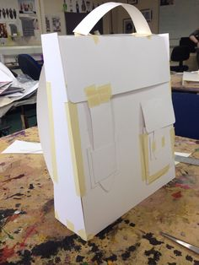
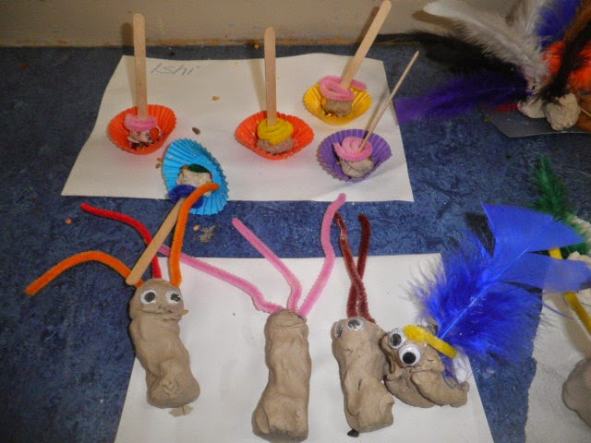
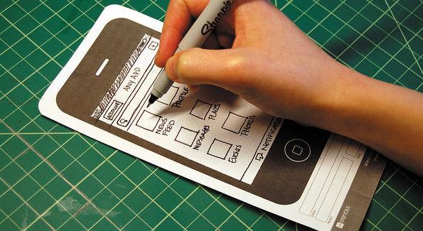
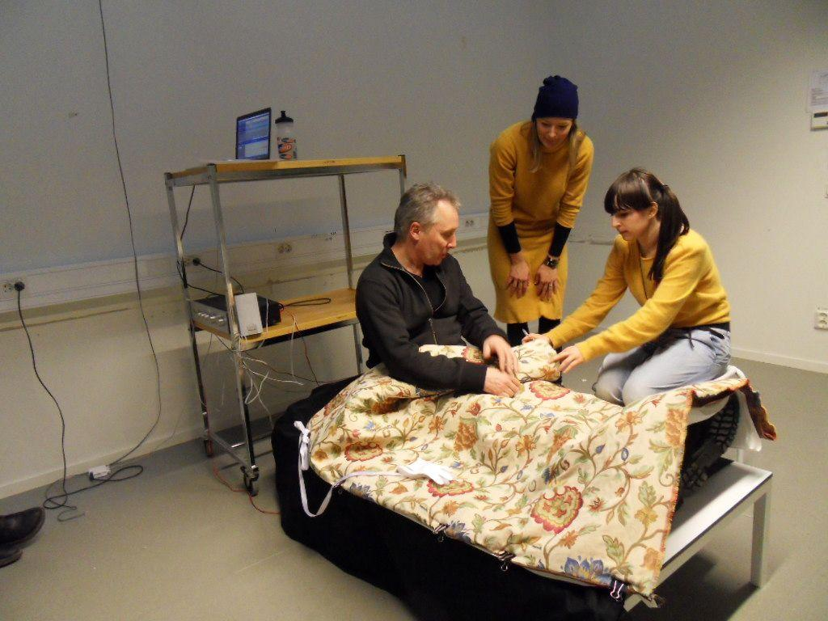
Prototypes
Objects
Experiences
Interfaces
Services
Notes:
Some tips for prototyping to test: Start building. Even if you aren’t sure what you’re doing, the act of picking up some materials (paper, tape, and found objects are a good way to start!) will be enough to get you going. Don’t spend too long on one prototype. Move on before you find yourself getting too emotionally attached to any one prototype. Build with the user in mind. What do you hope to test with the user? What sorts of behavior do you expect? Answering these questions will help focus your prototyping and help you receive meaningful feedback in the testing phase. ID a variable. Identify what’s being tested with each prototype. A prototype should answer a particular question when tested.

Slide 50
Build & test.
7. Build your solution.
10 min (silently)
Make something that your partner can interact with….
8. Share your solution and get feedback.
4 minutes
What worked…
What could be improved…
Questions…
Ideas…

Slide 51
09
59
58
57
56
55
54
53
52
51
50
49
48
47
46
45
44
43
42
41
40
39
38
37
36
35
34
33
32
31
30
29
28
27
26
25
24
23
22
21
20
19
18
17
16
15
14
13
12
11
10
09
08
07
06
05
04
03
02
01
00
Build & test.
7. Build your solution.
10 min (silently)
Make something that your partner can interact with….
8. Share your solution and get feedback.
4 minutes
What worked…
What could be improved…
Questions…
Ideas…

Slide 52
08
59
58
57
56
55
54
53
52
51
50
49
48
47
46
45
44
43
42
41
40
39
38
37
36
35
34
33
32
31
30
29
28
27
26
25
24
23
22
21
20
19
18
17
16
15
14
13
12
11
10
09
08
07
06
05
04
03
02
01
00
Build & test.
7. Build your solution.
10 min (silently)
Make something that your partner can interact with….
8. Share your solution and get feedback.
4 minutes
What worked…
What could be improved…
Questions…
Ideas…

Slide 53
07
59
58
57
56
55
54
53
52
51
50
49
48
47
46
45
44
43
42
41
40
39
38
37
36
35
34
33
32
31
30
29
28
27
26
25
24
23
22
21
20
19
18
17
16
15
14
13
12
11
10
09
08
07
06
05
04
03
02
01
00
Build & test.
7. Build your solution.
10 min (silently)
Make something that your partner can interact with….
8. Share your solution and get feedback.
4 minutes
What worked…
What could be improved…
Questions…
Ideas…

Slide 54
06
59
58
57
56
55
54
53
52
51
50
49
48
47
46
45
44
43
42
41
40
39
38
37
36
35
34
33
32
31
30
29
28
27
26
25
24
23
22
21
20
19
18
17
16
15
14
13
12
11
10
09
08
07
06
05
04
03
02
01
00
Build & test.
7. Build your solution.
10 min (silently)
Make something that your partner can interact with….
8. Share your solution and get feedback.
4 minutes
What worked…
What could be improved…
Questions…
Ideas…

Slide 55
05
59
58
57
56
55
54
53
52
51
50
49
48
47
46
45
44
43
42
41
40
39
38
37
36
35
34
33
32
31
30
29
28
27
26
25
24
23
22
21
20
19
18
17
16
15
14
13
12
11
10
09
08
07
06
05
04
03
02
01
00
Build & test.
7. Build your solution.
10 min (silently)
Make something that your partner can interact with….
8. Share your solution and get feedback.
4 minutes
What worked…
What could be improved…
Questions…
Ideas…

Slide 56
04
59
58
57
56
55
54
53
52
51
50
49
48
47
46
45
44
43
42
41
40
39
38
37
36
35
34
33
32
31
30
29
28
27
26
25
24
23
22
21
20
19
18
17
16
15
14
13
12
11
10
09
08
07
06
05
04
03
02
01
00
Build & test.
7. Build your solution.
10 min (silently)
Make something that your partner can interact with….
8. Share your solution and get feedback.
4 minutes
What worked…
What could be improved…
Questions…
Ideas…

Slide 57
03
59
58
57
56
55
54
53
52
51
50
49
48
47
46
45
44
43
42
41
40
39
38
37
36
35
34
33
32
31
30
29
28
27
26
25
24
23
22
21
20
19
18
17
16
15
14
13
12
11
10
09
08
07
06
05
04
03
02
01
00
Build & test.
7. Build your solution.
10 min (silently)
Make something that your partner can interact with….
8. Share your solution and get feedback.
4 minutes
What worked…
What could be improved…
Questions…
Ideas…

Slide 58
02
59
58
57
56
55
54
53
52
51
50
49
48
47
46
45
44
43
42
41
40
39
38
37
36
35
34
33
32
31
30
29
28
27
26
25
24
23
22
21
20
19
18
17
16
15
14
13
12
11
10
09
08
07
06
05
04
03
02
01
00
Build & test.
7. Build your solution.
10 min (silently)
Make something that your partner can interact with….
8. Share your solution and get feedback.
4 minutes
What worked…
What could be improved…
Questions…
Ideas…

Slide 59
01
59
58
57
56
55
54
53
52
51
50
49
48
47
46
45
44
43
42
41
40
39
38
37
36
35
34
33
32
31
30
29
28
27
26
25
24
23
22
21
20
19
18
17
16
15
14
13
12
11
10
09
08
07
06
05
04
03
02
01
00
Build & test.
7. Build your solution.
10 min (silently)
Make something that your partner can interact with….
8. Share your solution and get feedback.
4 minutes
What worked…
What could be improved…
Questions…
Ideas…

Slide 60
00
59
58
57
56
55
54
53
52
51
50
49
48
47
46
45
44
43
42
41
40
39
38
37
36
35
34
33
32
31
30
29
28
27
26
25
24
23
22
21
20
19
18
17
16
15
14
13
12
11
10
09
08
07
06
05
04
03
02
01
00
Build & test.
7. Build your solution.
10 min (silently)
Make something that your partner can interact with….
8. Share your solution and get feedback.
4 minutes
What worked…
What could be improved…
Questions…
Ideas…

Slide 61
Co-creation
: get feedback from user
Notes:
https://youtu.be/ZbFTVbLfbZA?t=33s
Go until 1:25

Slide 62
03
59
58
57
56
55
54
53
52
51
50
49
48
47
46
45
44
43
42
41
40
39
38
37
36
35
34
33
32
31
30
29
28
27
26
25
24
23
22
21
20
19
18
17
16
15
14
13
12
11
10
09
08
07
06
05
04
03
02
01
00
Build & test.
7. Build your solution.
10 min (silently)
Make something that your partner can interact with….
8. Share your solution and get feedback.
4 minutes
What worked…
What could be improved…
Questions…
Ideas…

Slide 63
02
59
58
57
56
55
54
53
52
51
50
49
48
47
46
45
44
43
42
41
40
39
38
37
36
35
34
33
32
31
30
29
28
27
26
25
24
23
22
21
20
19
18
17
16
15
14
13
12
11
10
09
08
07
06
05
04
03
02
01
00
Build & test.
7. Build your solution.
10 min (silently)
Make something that your partner can interact with….
8. Share your solution and get feedback.
4 minutes
What worked…
What could be improved…
Questions…
Ideas…

Slide 64
01
59
58
57
56
55
54
53
52
51
50
49
48
47
46
45
44
43
42
41
40
39
38
37
36
35
34
33
32
31
30
29
28
27
26
25
24
23
22
21
20
19
18
17
16
15
14
13
12
11
10
09
08
07
06
05
04
03
02
01
00
Build & test.
7. Build your solution.
10 min (silently)
Make something that your partner can interact with….
8. Share your solution and get feedback.
4 minutes
What worked…
What could be improved…
Questions…
Ideas…

Slide 65
00
59
58
57
56
55
54
53
52
51
50
49
48
47
46
45
44
43
42
41
40
39
38
37
36
35
34
33
32
31
30
29
28
27
26
25
24
23
22
21
20
19
18
17
16
15
14
13
12
11
10
09
08
07
06
05
04
03
02
01
00
Build & test.
7. Build your solution.
10 min (silently)
Make something that your partner can interact with….
8. Share your solution and get feedback.
4 minutes
What worked…
What could be improved…
Questions…
Ideas…

Slide 66
Notes:
https://youtu.be/ZbFTVbLfbZA?t=33s
Go until 1:25

Slide 67
EMPATHY
Goal This Week: Practice
within the context of snacking
Notes:
7:00-7:45pm: User Interview Debriefs
7:45pm - 8:30pm: Prototyping Exercise
8:30pm - 9pm: Review of what we have learned

Slide 68
1
observe customers purchasing snacks
To Do’s
3
2
interview a friend
wessling@wharton.upenn.edu
interview a stranger
Notes:
7:00-7:45pm: User Interview Debriefs
7:45pm - 8:30pm: Prototyping Exercise
8:30pm - 9pm: Review of what we have learned

