Slide 1
MW to molecular formula
If even; no halides
  If hydrocarbon – #C = (mol wt.-2) / 14 (round UP!)
  Calculate IHD from #C and #H
  Alternate formulas with O: Add in O, take away CH₄, increase IHD by 1
  Alt. formulas with 2 N: Add in N₂, take away C₂H₄, increase IHD by 1
  Alt. formulas with S: Add in S, take away C₂H₈, increase IHD by 2
  If IHD becomes 7 or more, consider alt. with one fewer C, 12 more H
If one halide
  Detect by M+2 peaks (Cl, Br) or M-19 pk (F; may be small) or M-127 (I)
  Subtract 18, 34, 78 or 126 from M to find wt. if halide replaced by H
If odd then odd number of nitrogens (1, 3 or 5)
  Subtract 15, 45 or 75 from M
  determine formula as above
  add in NH, N₃H₃ or N₅H₅
Notes:
Example with 106
(106-2)/14 = 7.4 → round up to 8
8*12 = 96 so C8H10, IHD = 4
Alt w O: C7H6O, IHD = 5
Alt w 2O: C6H2O2, IHD = 6
Alt w 2N: C6H6N2, IHD = 5
Alt w 4N: C4H2N4, IHD = 6
Alt w S: C6H2S, IHD = 6
If evidence for Cl: M’=72 (106-34)
#C = (72-2)/14 = 5: C5H12 → C5H11Cl (IHD = 0)
Alt w/ O: C4H7ClO (IHD = 1)
Alt w 2O: C3H3ClO2 (IHD = 2)
Alt w 2N: C3H7ClN2 (IHD = 1)

Slide 2
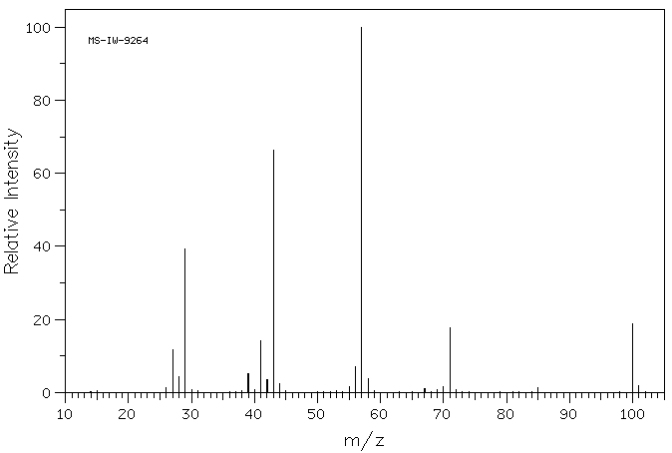
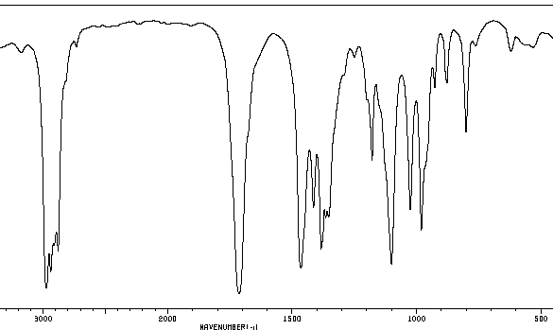
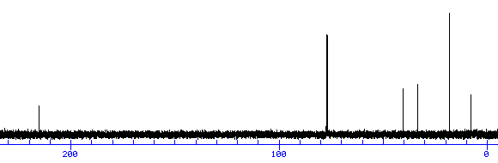
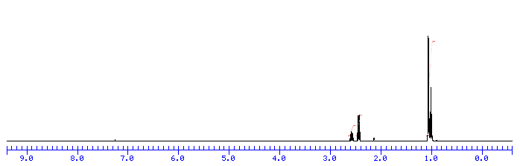
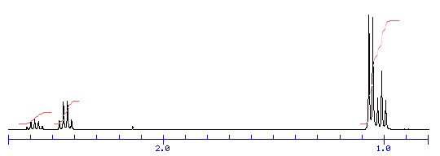
compound A

Slide 3
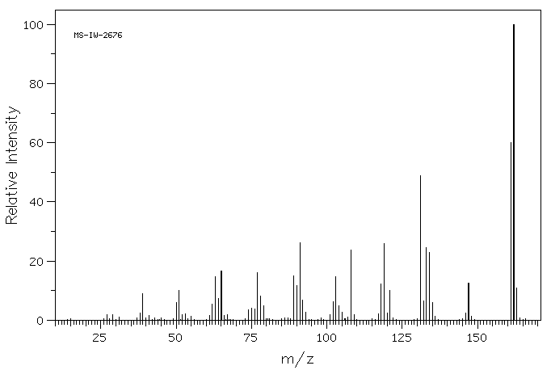
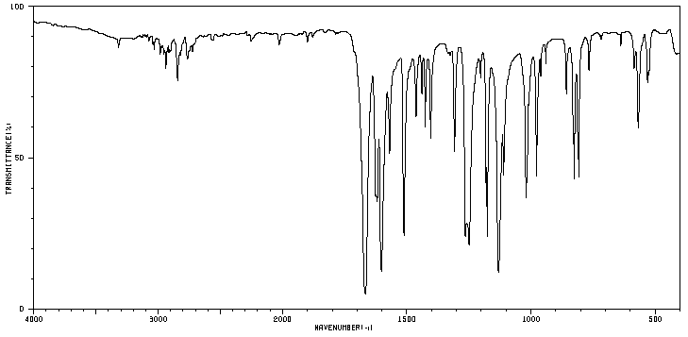
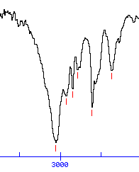
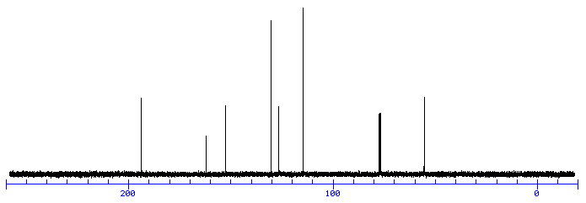
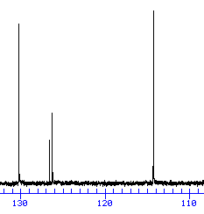
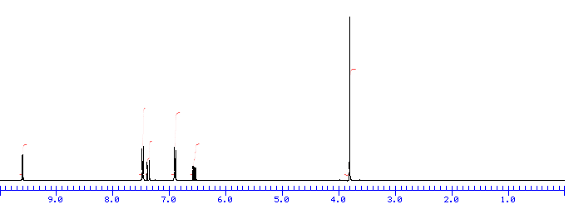
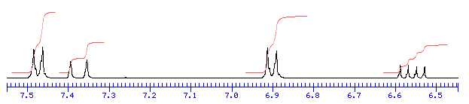
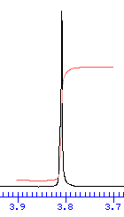

3200
2800 cm-¹
compound B

Slide 4
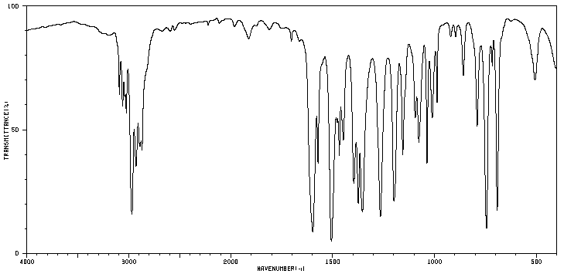
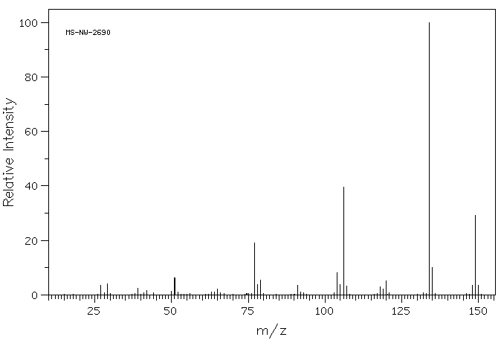
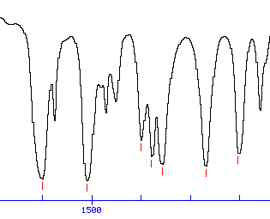
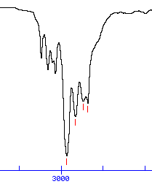
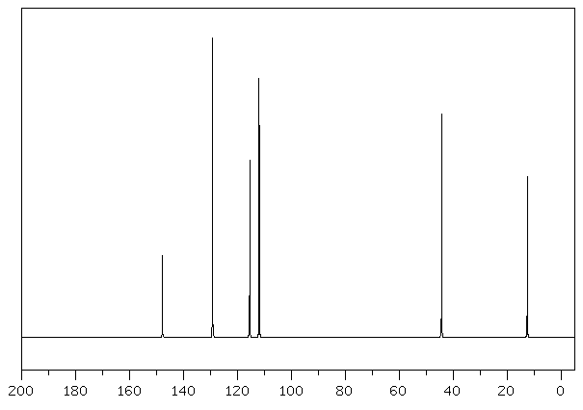
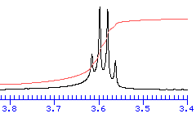
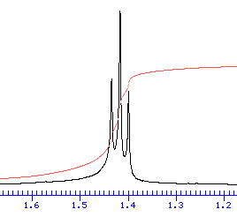
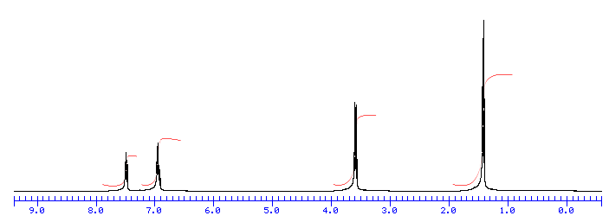
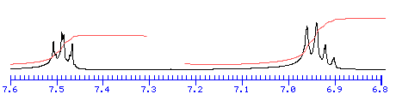
3200
2800 cm-¹
1600
1400
1300
1200 cm-¹
unknown C

Slide 5
Solutions
View in Powerpoint – Slide Show presentation mode – and click on the right arrow button repeatedly to advance animations
This shows one possible order for considering the spectral clues to arrive at the structure conclusion.

Slide 6
M = 100 amu
C₇H₁₆ (IHD = 0)
C₆H₁₂O (IHD = 1)
C₅H₈O₂ (IHD = 2)
C₅H₁₂N₂ (IHD = 1)
1710 cm⁻¹
C=O
(aldehyde,
ketone
or acid)
5 different C
environments
(one 4°, one double)
CDCl₃
215 ppm
C=O
(aldehyde,
ketone)
compound A
9
1:6:10:15:10:6:1
septet?
Ethyl
3(t)
nothing 9-13 ppm (so no aldehyde or acid)
1 2(q)
(quint)
6
(d)
Isopropyl

Slide 7
M = 162 amu
C₁₂H₁₈ (IHD = 4)
C₁₁H₁₄O (IHD = 5)
C₁₀H₁₀O₂ (IHD = 6)
C₁₀H₁₄N₂ (IHD = 5)
-OCH₃ & -CHO require 2 O
para-disubst. benzene:
¹H doublets 7.5 and 6.9 ppm
¹³C double height pks 130 & 114 ppm
strong IR ≈ 825 cm⁻¹ (and not 700-800)
3200
2800 cm-¹
compound B
large coupling suggests trans-alkene
2 1 2 1
3
methoxy
(singlet, integr.=3 & δ = 3.8)
aldehyde
6 H in aromatic (+ alkene?) region
1

Slide 8
Two possible structures (trans-alkene + aldehyde + methoxy + para-disubstituted benzene
(and NMR coupling and shift predictions; shift predictions based on handout from 18 Nov)
YES!
NO!
2 1 2 1
3
1

Slide 9
M = 162 amu
C₁₂H₁₈ (IHD = 4)
C₁₁H₁₄O (IHD = 5)
C₁₀H₁₀O₂ (IHD = 6)
C₁₀H₁₄N₂ (IHD = 5)
-OCH₃ & -CHO require 2 O
para-disubst. benzene:
¹H doublets 7.5 and 6.9 ppm
¹³C double height pks 130 & 114 ppm
strong IR ≈ 825 cm⁻¹ (and not 700-800)
3200
2800 cm-¹
compound B
large coupling suggests trans-alkene
2 1 2 1
3
methoxy
(singlet, integr.=3 & δ = 3.8)
aldehyde
6 H in aromatic (+ alkene?) region
1

Slide 10
M = 149 amu
Odd, so at least one N
C₁₀H₁₅N (IHD = 4)
C₉H₁₁NO (IHD = 5)
C₈H₇NO₂ (IHD = 6)
C₈H₁₁N₃ (IHD = 5)
No N-H stretch (would expect 3200-3400 cm⁻¹ broad)
Phenyl + 2 Et = C₁₀H₁₅. So just missing N.
750 & 690 cm⁻¹ CH bends for phenyl group
sp² C-H
(>3000)
sp³ C-H
(<3000)
3200
2800 cm-¹
1600
1400
1300
1200 cm-¹
unknown C
1500, 1600 cm⁻¹ may be aromatic C-C stretches)
q and t with rel. integrations 2:3 indicate ethyl group
H on aromatic ring. Integr. 2+3 total 5.
Monosubst. benzene (i.e. phenyl group)
integrations 2x those in aromatic region.
Therefore, 2 Et groups

